Slide 1
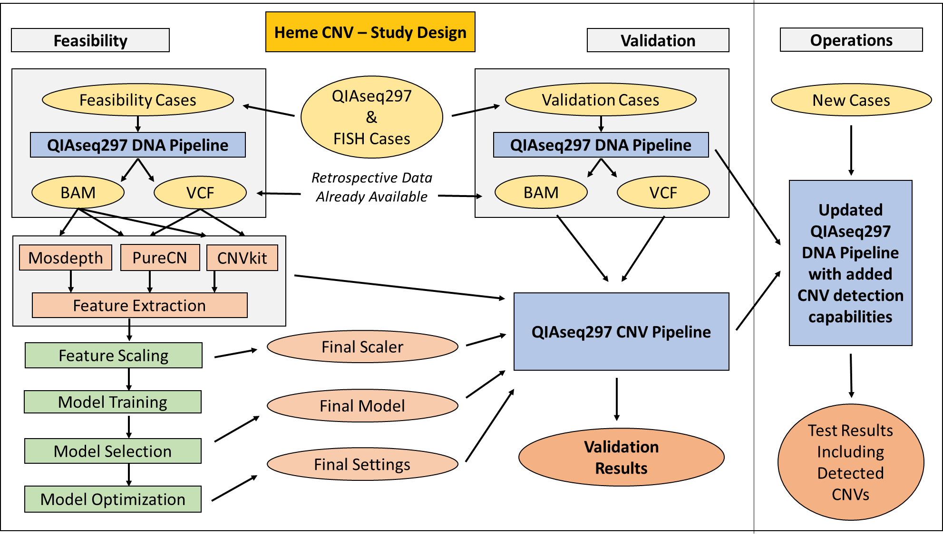
Heme CNV - Overview
Dr. Christophe Magnan

Slide 2
Heme CNV – Data Collection
Extracted Metadata Mapping, Merging,
And Filtering
FISH Reports
387,938 Total
FISH Results
Extraction
NGS Reports
113,456 Total
NGS Sample Metadata Extraction
Heme CNV Data
9,015 Concurrent Cases
364,210 Genes With CNV Information
From FISH
Isilon
257,951 BAM
176,547 VCF
NGS Data + Quality Controls

Slide 3
Heme CNV – Features
QIAseq297
Pipeline
270 genes covered by the CNV methods
VCF
BAM
PureCN
CNVkit
Mosdepth
Segment-Level Log₂(CN) x 4
Gene-Level Log₂(CN) x 6
Normalized Coverage 1
…
Normalized Coverage 10
Predictions From Existing Tools
PureCN and CNVkit selected
Baseline accuracy: 95% to 96%
Predicted Log₂(CN) used as found
Gene and segment level results
Confidence intervals included
Expected > 0 for amp and < 0 for del
Normalized Coverages
Classic and experimental features
11K samples to assess assay-specific coverage variations and biases
Comparison between gene coverage and other elements / expected normal
Expected > 1 for amp and < 1 for del
Dr. Christophe Magnan

Slide 4
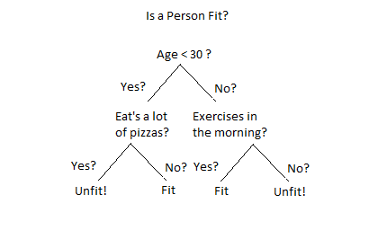

Heme CNV – Random Forest Classifier
Gene with unknown CNV information
252,858 genes with known CNV information
Features +
Random Forest
Training Algorithm
CNV Result
Features
Random Forest CNV Model
CNV Result
CNV Prediction
Loss: 71.23%
Gain: 03.56%
Normal: 25.21%

Slide 5
Heme CNV – Pipeline Validation

Slide 6
Heme CNV – Pipeline Validation Results
Model evaluated on each of the 62 genes
111,352 individual tests performed (1 gene x 1 sample)
Baseline accuracy (CNVkit, PureCN): 95% to 96%
Validation results summary:
Performance Characteristics | Percentage
Accuracy | 98.17%
Sensitivity | 95.98%
Specificity | 98.36%

Slide 7
Heme CNV –Pipeline Validation Summary
Ensemble approach provides between 2% and 3% improvement
Limit of detection: 20% abnormal cells / tumor content
No limitation on the number of copies above the LOD
Homozygous/heterozygous deletions both detected
Gains detected with as low as 3 copies of the gene
No matched normal sample required
270 QIAseq297 genes covered by the methods
3 genes included in the recently launched ALL panel

